Slide 2

Project 1 Bio Page
Developing a simple webpage

Slide 3
Learning Objectives
Practice designing a webpage
Practice coding a webpage
Practice using HTML editor
Can “hand code” the page
Try not to use your free download yet
May submit better design as second submission (second page)

Slide 4
Your goals
Clearly communicate to me (Ric, the old guy) that you understand;
how to follow specifications
the basics of web design
the basics of containerization
the proper use of photos
simply and clearly coding a page with
no CSS
no javaScript
proper web development documentation

Slide 5
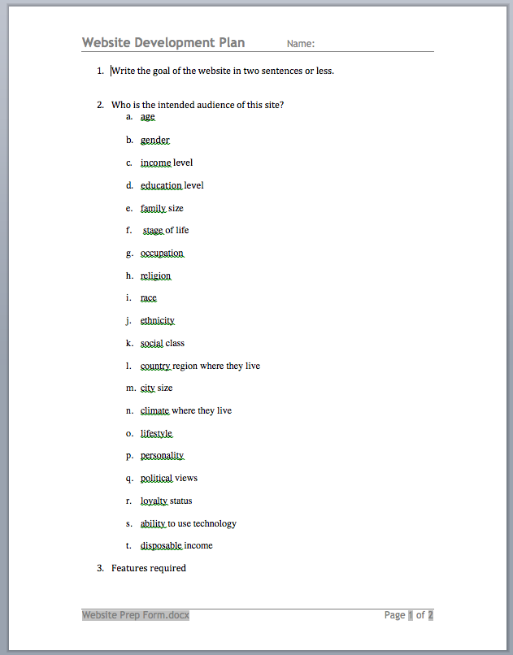
First things first

Slide 6
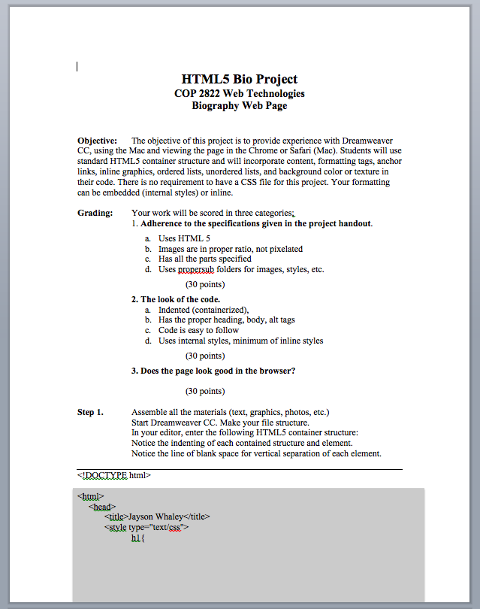
Specifications things second

Slide 7
Web development programs
Squarespace.com
WordPress
Adobe Dreamweaver
NotePad ++ (Windows)
WIX.com
Adobe Muse
xCode
TextEdit
Notepad
Most is done for you
Abundant Assistance Little to none
You have complete control

Slide 8
Web development programs
Squarespace.com
Adobe Dreamweaver
NotePad ++ (Windows)
WordPress
Adobe Muse
xCode
TextEdit
Notepad
Most is done for you
Abundant Assistance Little to none
You have complete control

Slide 9
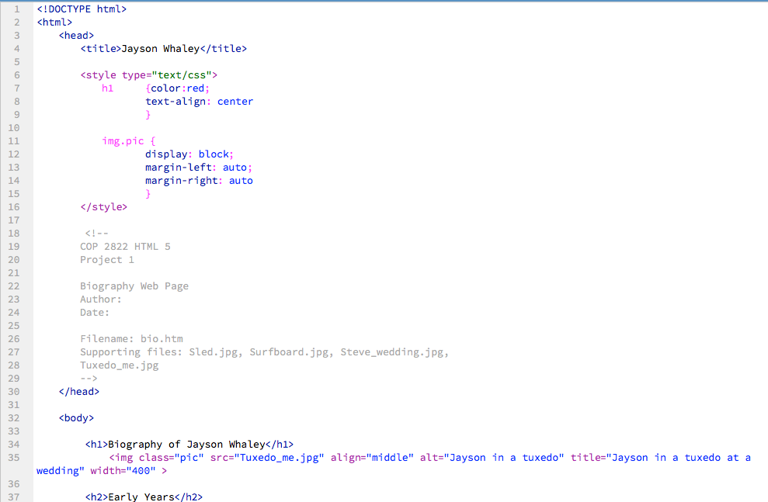
Three locations for formatting
CSS – External Style Sheet
Embedded Styles
Inline Style
Formatting Order of Precedence
Inline Style
Embedded Styles
CSS – External Style Sheet

Slide 12
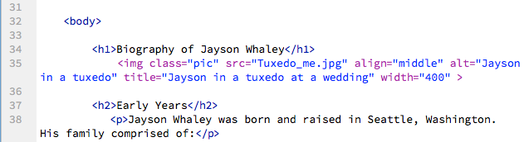

Slide 13
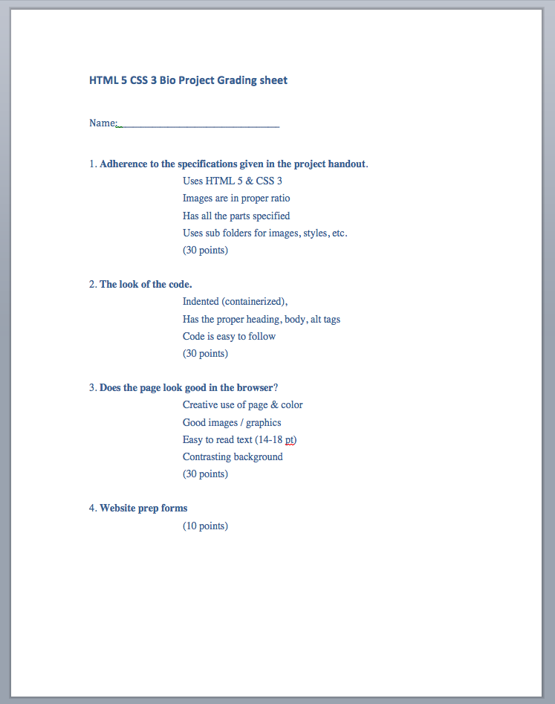
How you will be scored

Slide 14
What is due and when?
Due: Tuesday, Feb 24 at 1 PM
Must bring it to class and load it on instructors Mac
YourLastname Bio project
Flash drive with page and sub folders
Website Development Plan

Slide 15
Project 1 Development Checklist
Study the specs.
Define your goals.
Define your audience.
Complete the Web Development Plan.
Gather all the content.
Rough code the site.
Cut and paste content into rough code.
Smooth up the formatting.
Project 1 Handout
Web Development Plan handout
Web Development Plan handout

Slide 17
Your goals
Clearly communicate to _______________ that you understand;
How to _____________________
the basics of _____________________
The basics of _____________________
The proper use of _____________________
Simply and clearly coding a page with
No _____________________
No _____________________
Proper ____________________________________________

Slide 18
Web development programs
Most is done for you
Abundant Assistance Little to none
You have complete control

